Slide 1
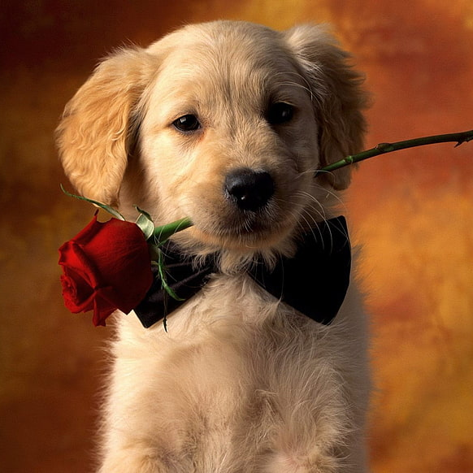

Dog breed Identification
Hari Kiran, Sasidhar, Vamsi

Slide 2
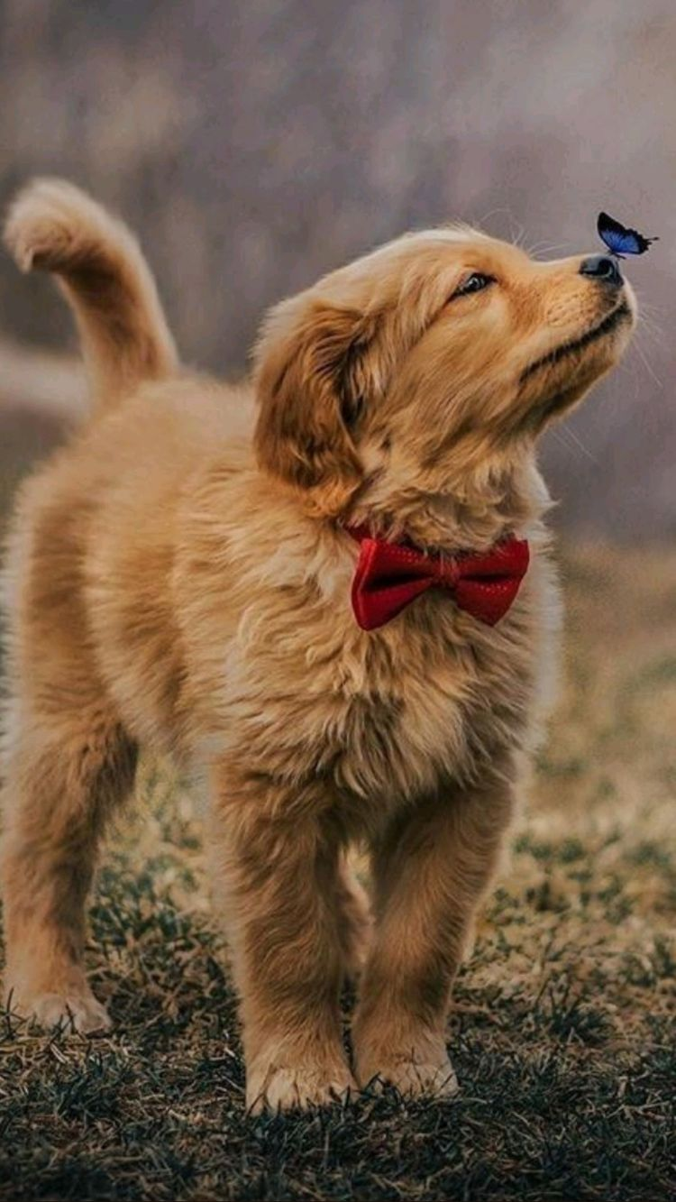
Problem Statement and Importance
Importance:
Time-saving: With automatic identification, it can save time for veterinarians or dog breeders to identify the breed of a dog quickly, especially in cases where the dog's breed is unknown.
Improved accuracy: Automatic identification using deep learning techniques can improve the accuracy of identifying dog breeds compared to human identification, as humans may have biases or lack knowledge about certain dog breeds.
Improved dog breeding: Automatic identification can aid in dog breeding by ensuring the correct breed of dogs are bred together, leading to healthier and more desirable offspring.
Better dog care: Knowing the breed of a dog can help with understanding its specific needs, such as dietary requirements, exercise needs, and potential health issues, leading to better care for the dog.
Our main aim with this project is to identify the breed of the dog given the picture of the dog.

Slide 3
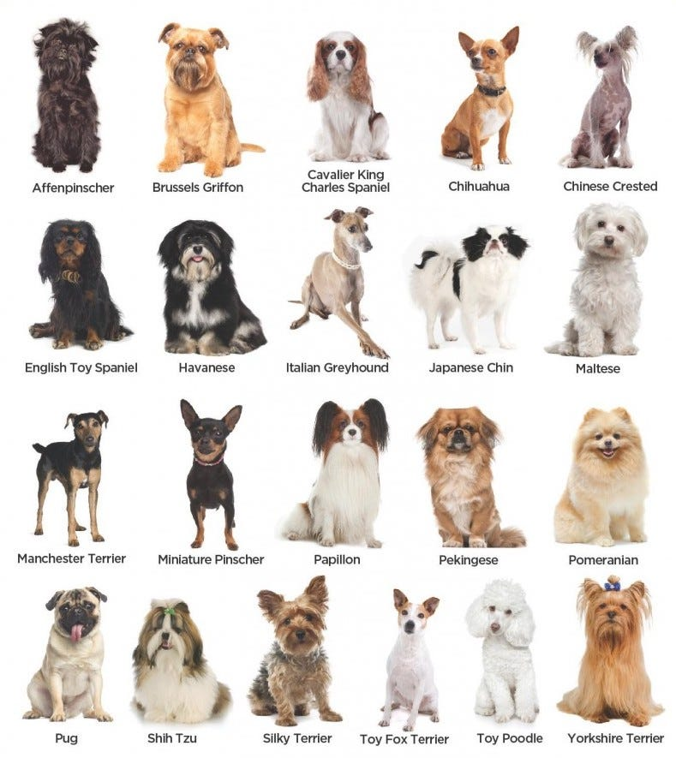
Dataset
The dataset used for this project is taken from Kaggle which contains images of dogs belonging to 120 different breeds. The dataset contains a total of 10222 dog images, which are divided into three sets: training set (6,517 images), validation set (1,533 images), and test set (2,1712 images).
Each image is given a unique name and the image name and the dog breed are provided in a separate CSV file. This can help us in determining what the dog breed is of an image.
The dataset presents a challenging computer vision problem due to the high level similarity between some of the dog breeds.

Slide 4
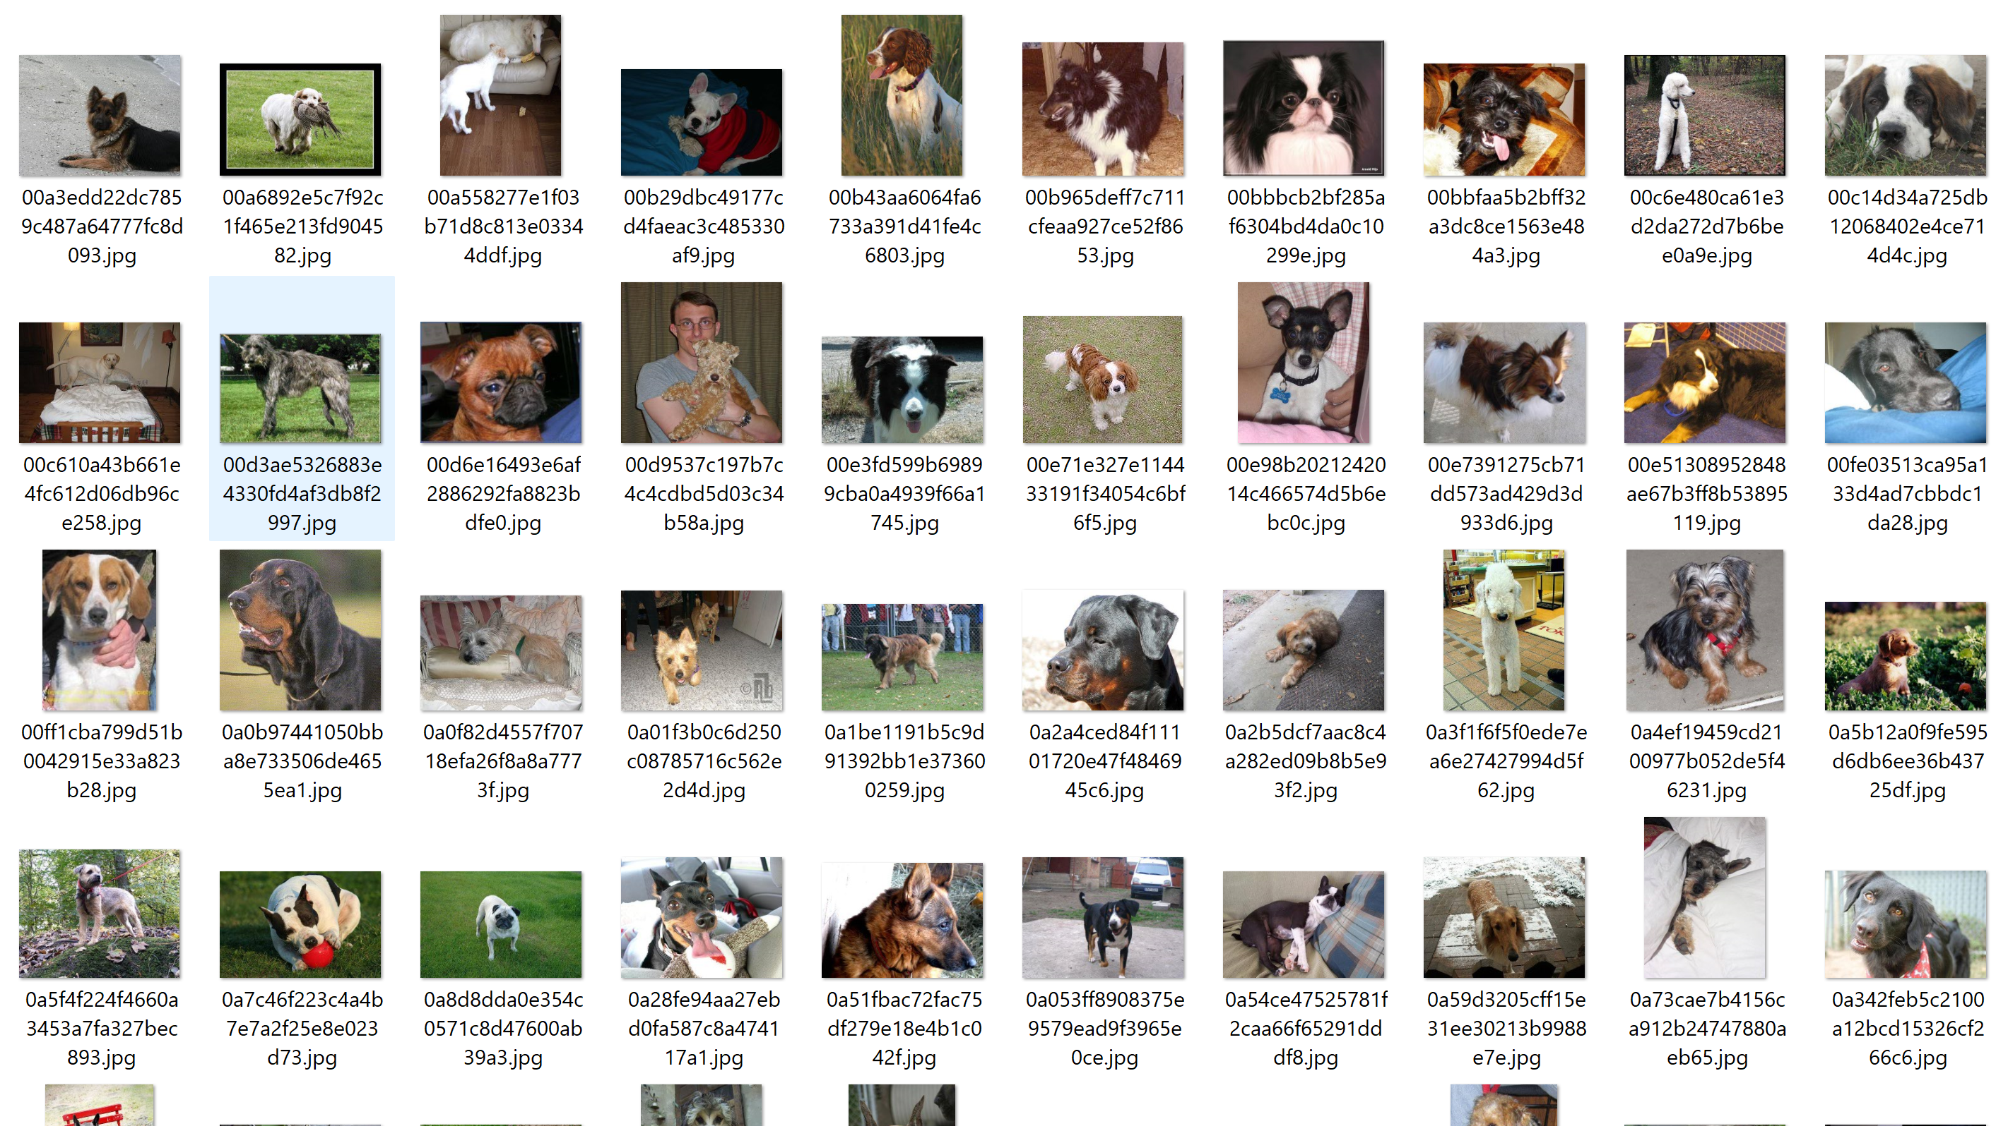
Sample Images from the dataset

Slide 5
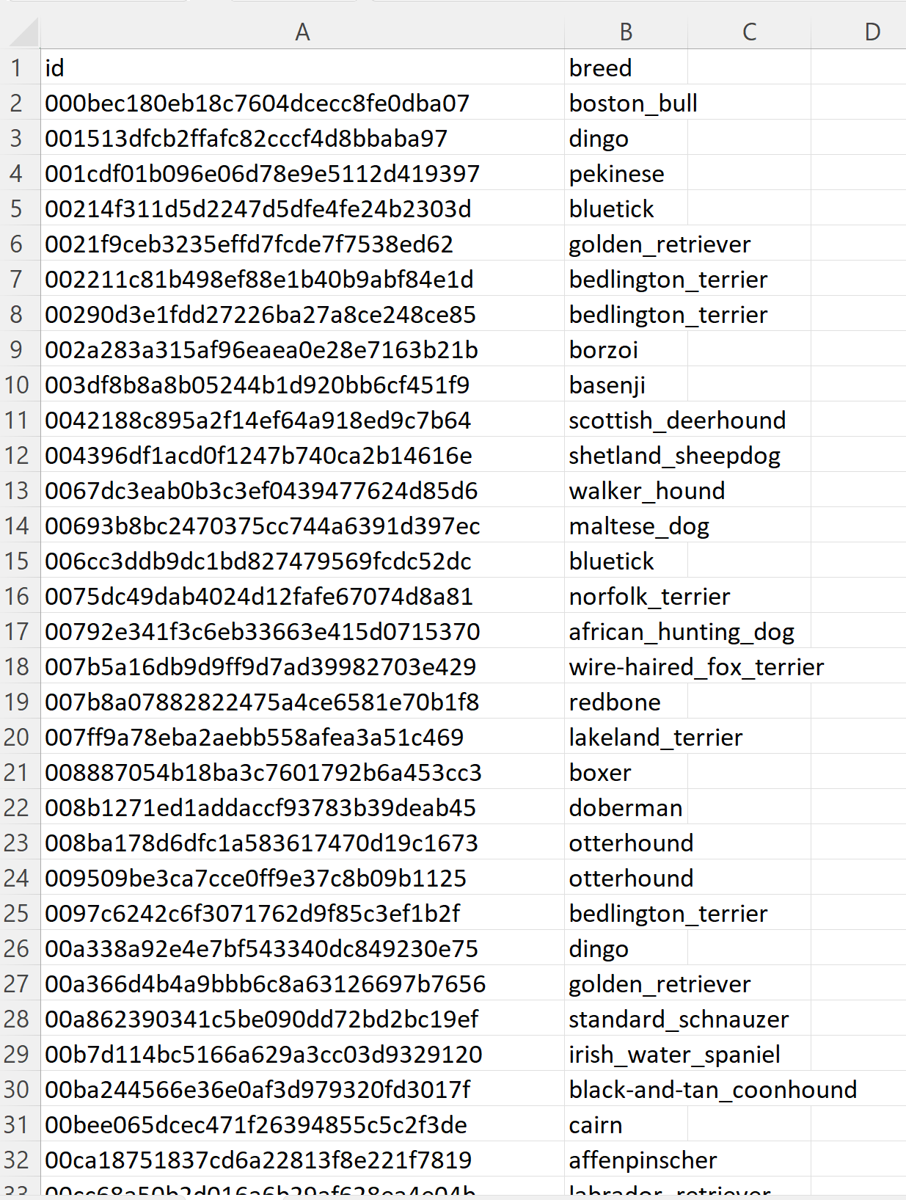
Sample CSV file

Slide 6
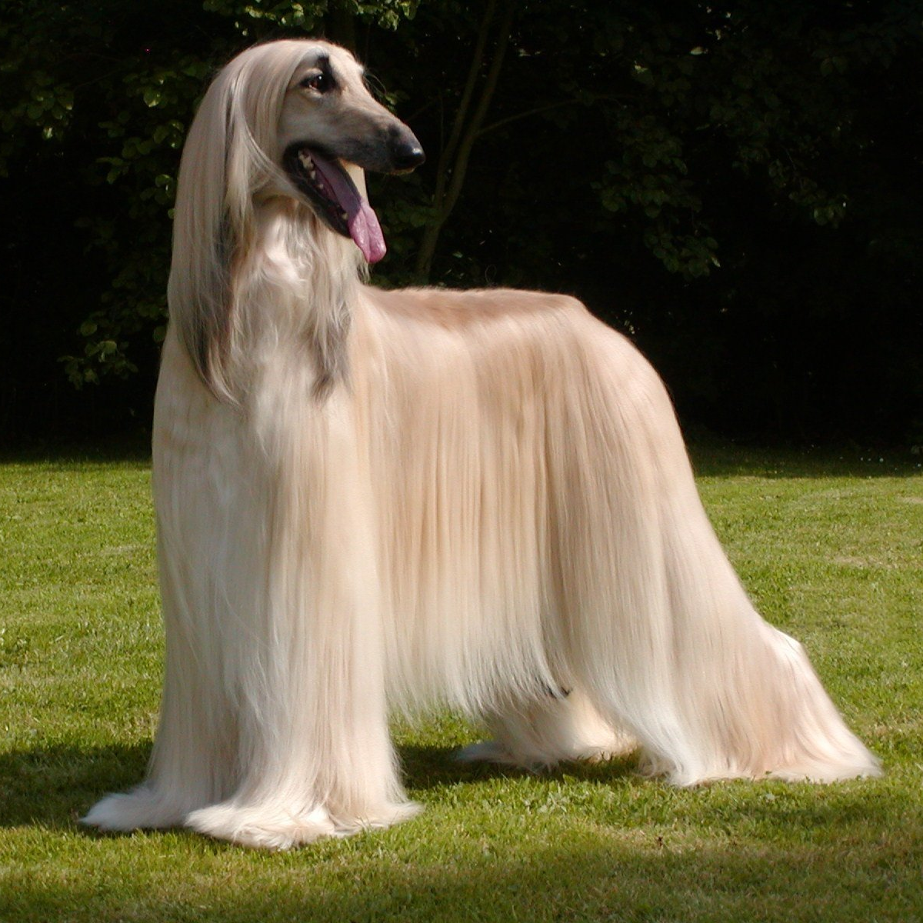
Proposed Models
We are using multiple CNN architectures which will be commonly used for image classification tasks in computer vision.
These are the architectures we have used:
Resnet50
InceptionV3
EfficientNet
VGG16
MyCNN (our own CNN built using Pytorch)

Slide 7
Proposed Models
We have fine-tuned the pre-trained models on our dog breed dataset by training the last layer of the model while freezing the rest. The final output layer will have 120 features, each representing a dog breed. We have used the softmax activation function to obtain the probability of each breed and the breed with the highest probability will be predicted as output.
Out of all the models, we have seen that InceptionV3 and EfficientNet produced highest accuracy. So, we saved those models and deployed them to Android Application.

Slide 8
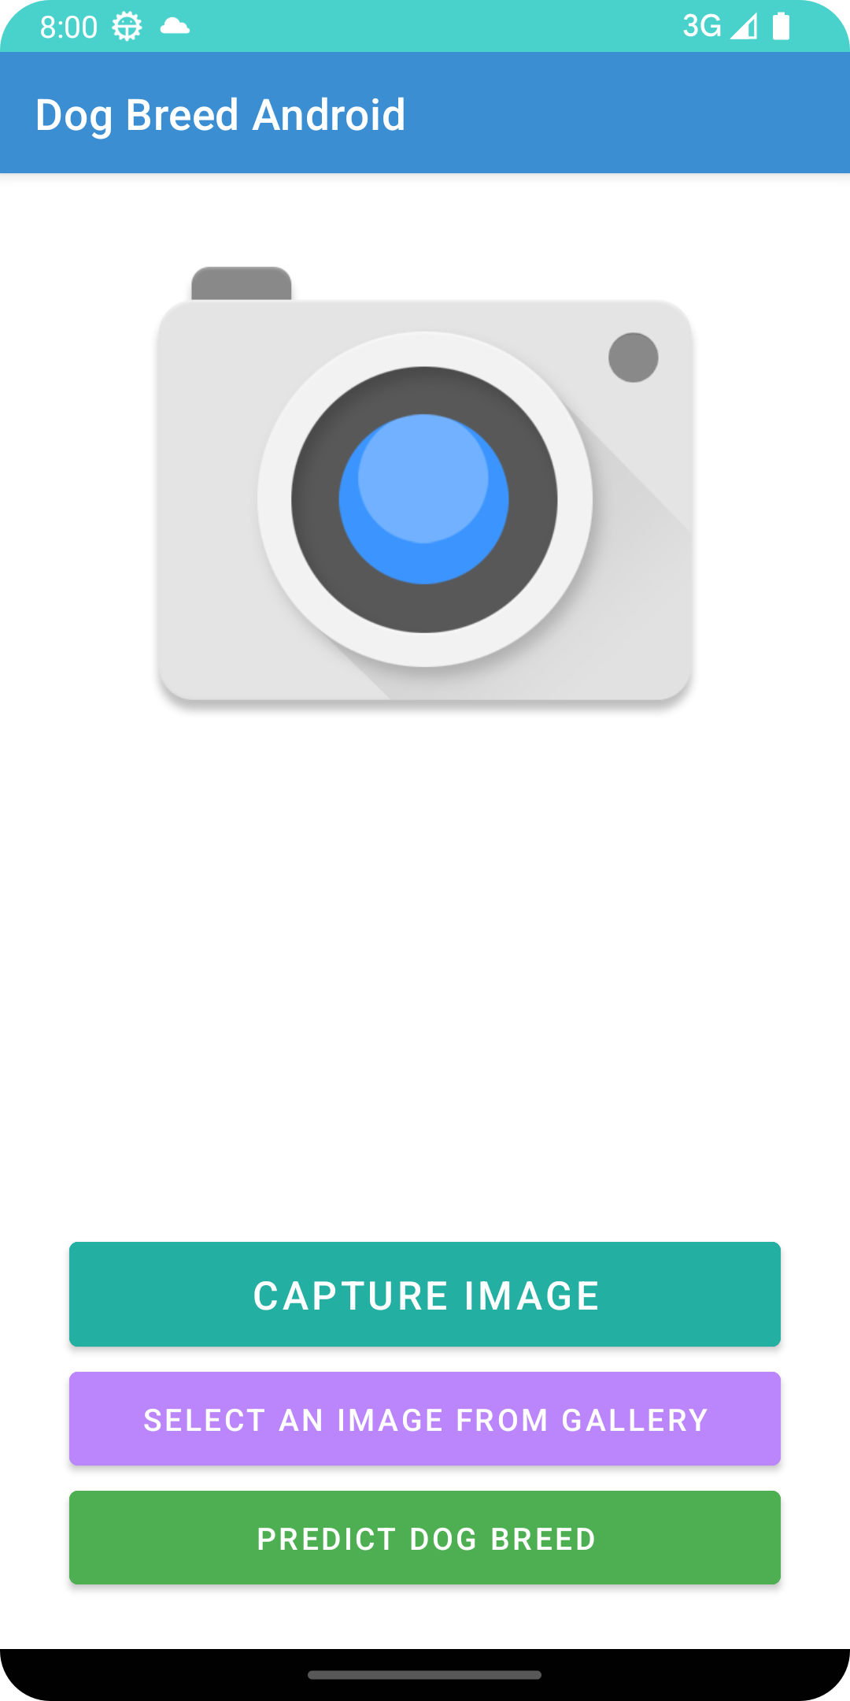
Android App Preview – Home Screen

Slide 9

Android App Preview – Capture Image

Slide 10
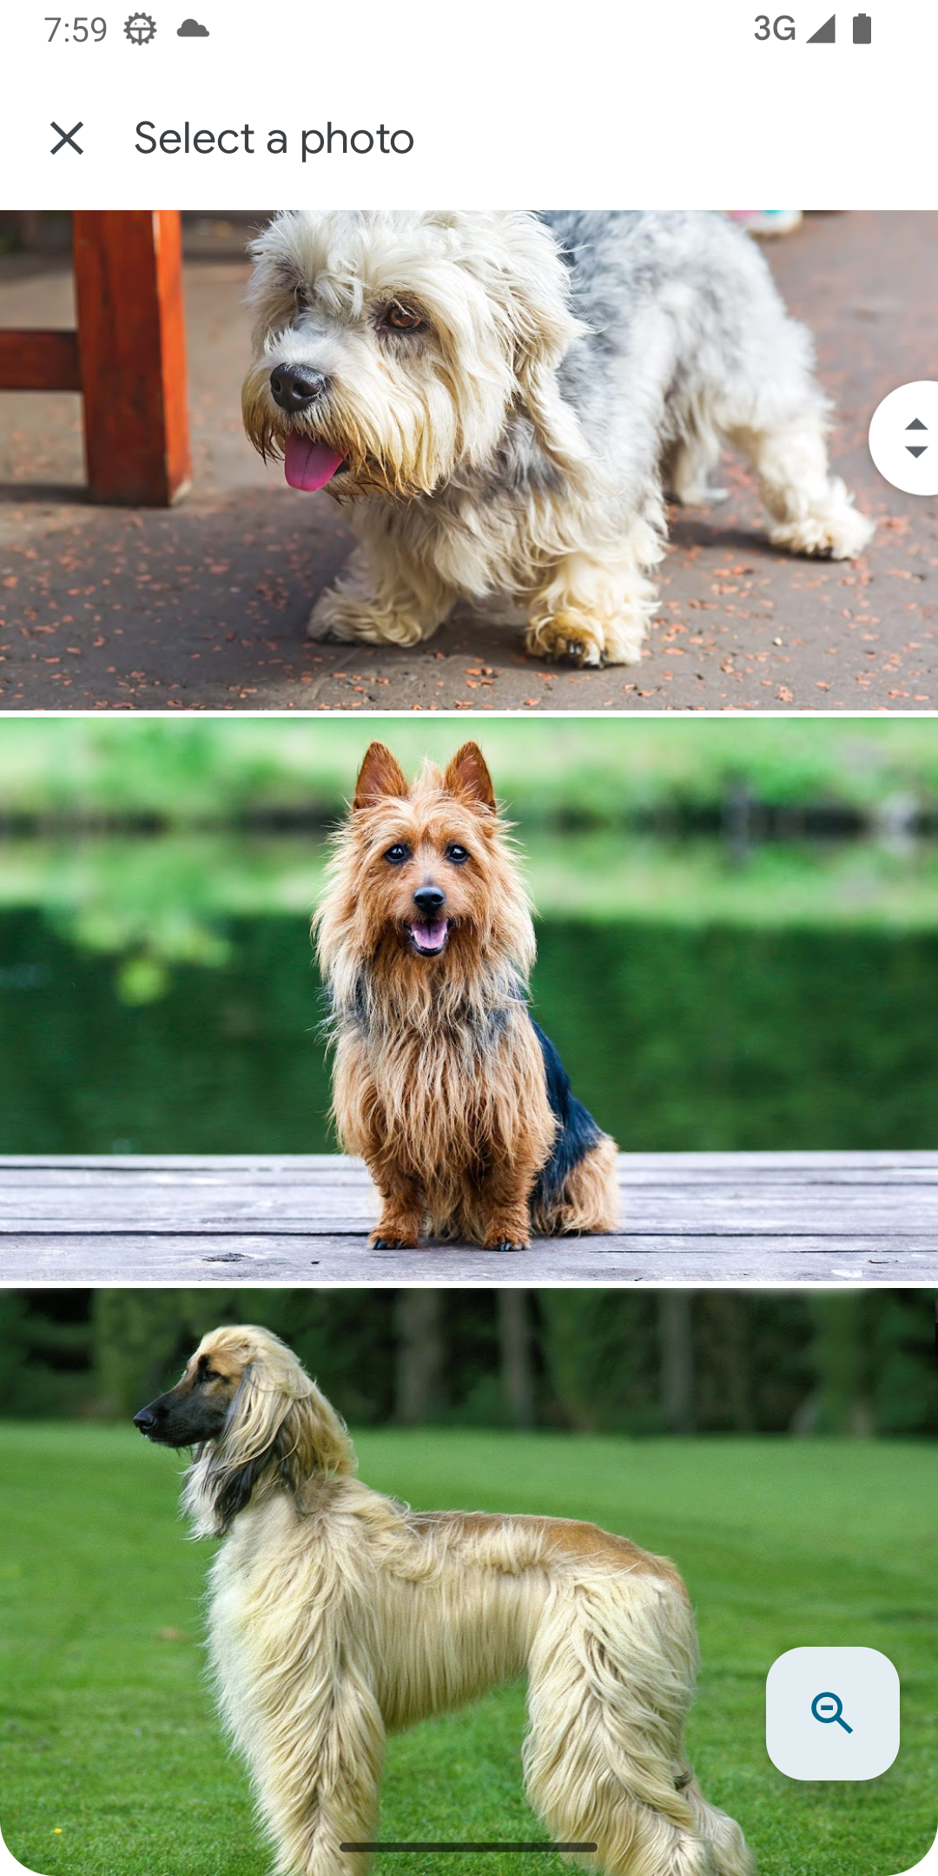
Android App Preview – Select Images from Gallery

Slide 11
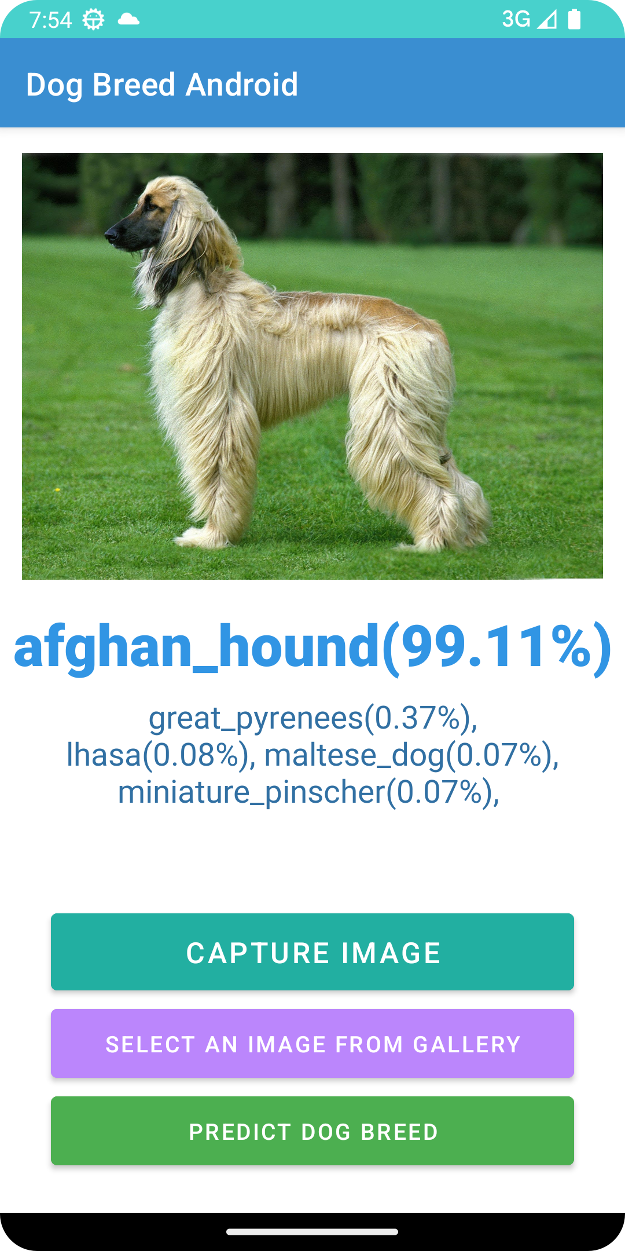
Android App Preview – Predict dog breed

Slide 12
Android App Preview
If you have an Android Device try our app by downloading it from here!
https://drive.google.com/file/d/1IR_H0E9-MomQvZa7heD4QEbatMtw2DOn/view?usp=sharing

Slide 13

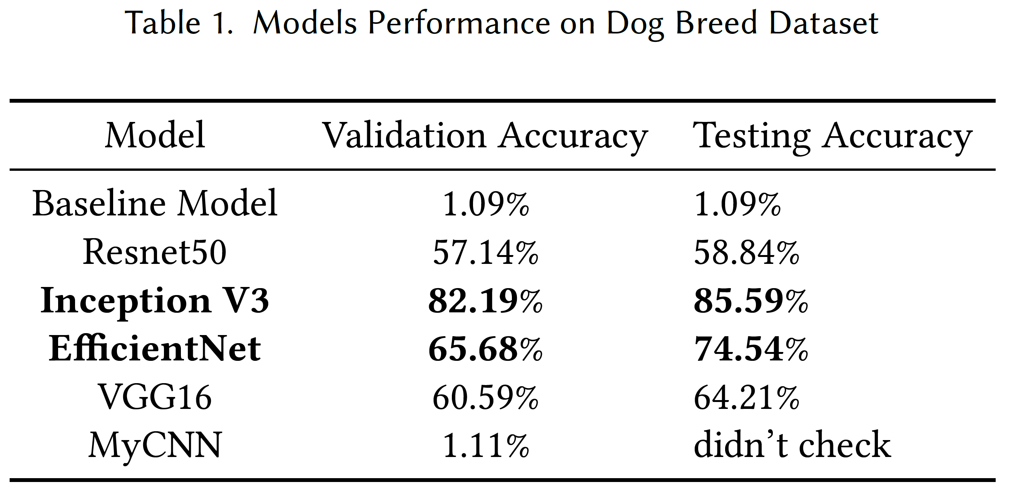
Results

Slide 14

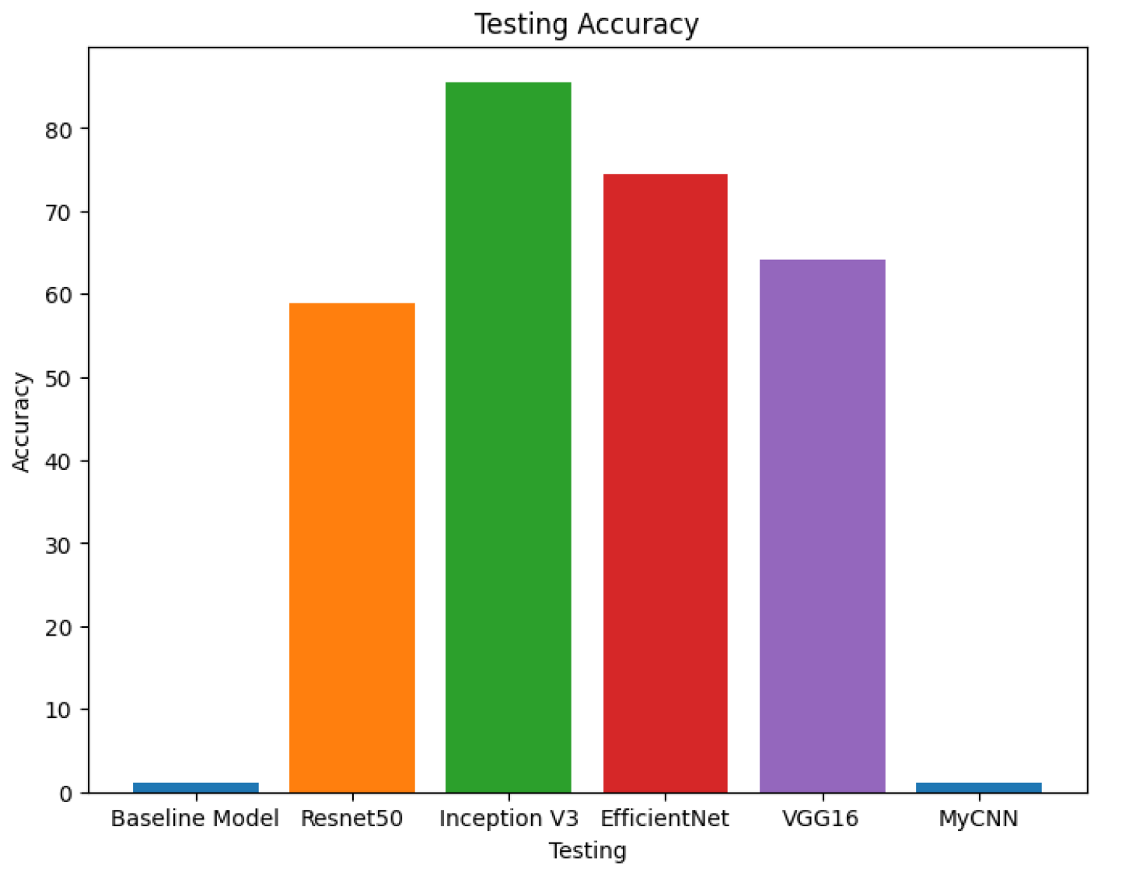
Results

Slide 15

Discussion
The InceptionV3 model achieved a classification accuracy of 85.59% on the test dataset, which is a pretty good result considering the complexity of the task. But one of the main drawbacks of this project is that the dataset size is very small. We could have scraped the web for more dogs and searched online for more dog datasets and combine them.
However, we can see the potential of pretrained models and transfer learning in the field of Computer Vision.
Our final conclusion is that pretrained models work! So, next time you think of solving a computer vision problem, the first thing that you have to think is of using pretrained models and modifying them to fit your own image classification tasks. There is no need to spend huge amounts of time and computing to train a model from scratch because as we can see that these models are robust and work quite well to most of the Computer Vision Problems.

Slide 16
Special Thanks to Professor Yan Huang and to the Teaching Assistants Riyad Bin Rafiq and Zhaomin Xiao. This project helped us gain valuable experience in doing real world projects and using CNNs and Transfer Learning

Slide 17
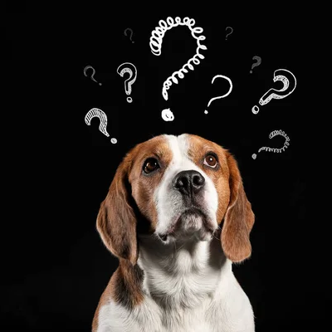
Any Questions?

